Slide 1
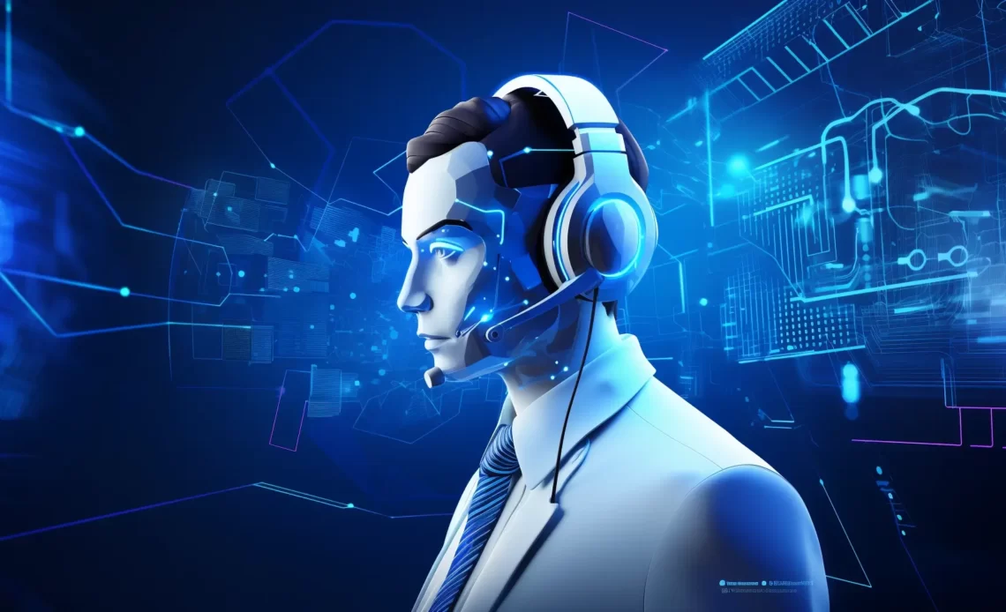

SupportGenie:AI-Powered Multi-Turn Customer Assistance
PRESENTED BY:
VARSHITHA Y
SANGHAVI Y
MANOGNA R

Slide 2
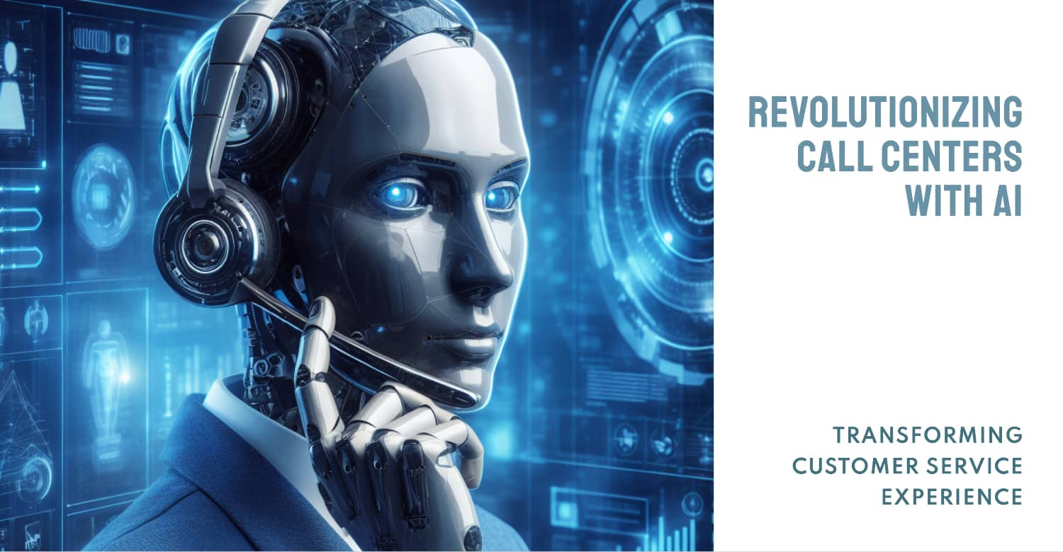

Introduction
What is this project about?
✅ AI-driven customer support agent that automates query handling.
✅ Uses LangGraph for structured multi-turn conversations.
✅ Integrates Retrieval-Augmented Generation (RAG) for accurate
Why this project?
✅ Traditional chatbots struggle with context & multi-turn queries.
✅ Manual support is expensive and time-consuming.
✅ RAG-based AI improves accuracy & scalability.

Slide 3
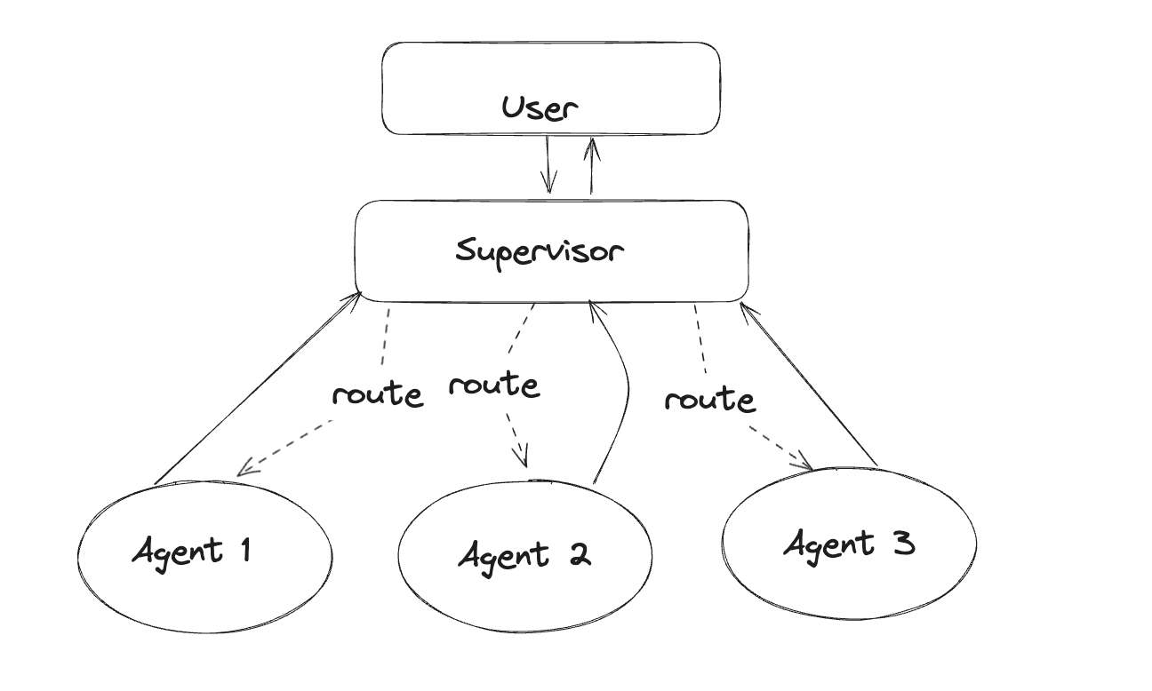
Understanding LangGraph
What is LangGraph?
✅ Framework for AI-driven workflows using state, nodes, edges, and tools.
✅ Allows multi-step AI reasoning & structured dialogues.
✅ Manages decision trees for intelligent agent behavior.
WHY LANGGRAPH FOR CUSTOMER SUPPORT?
✅ Retains memory across conversations.
✅ Handles dynamic query resolution with conditional logic.
✅ Improves response relevance using knowledge retrieval.

Slide 4
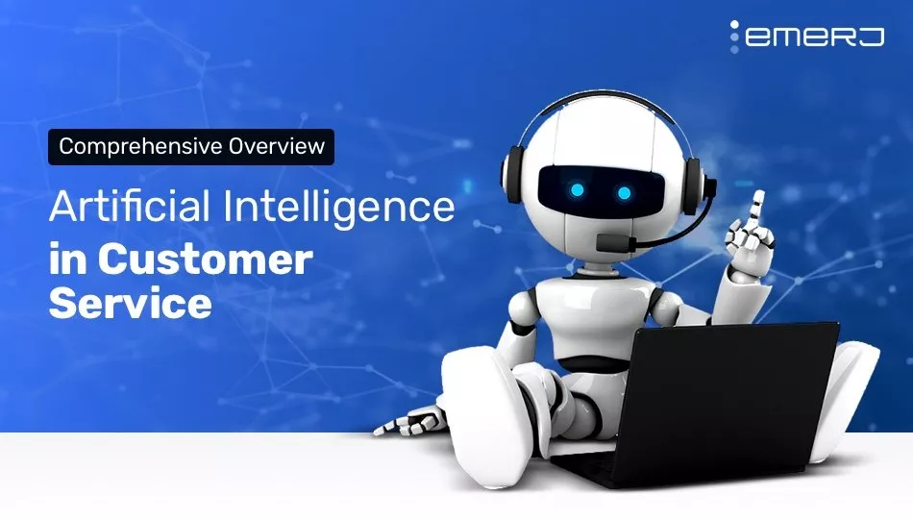
01
How Our Customer Support Agent Works
USER QUERY PROCESSING
Understands customer intent.
02
RETRIEVAL FROM KNOWLEDGE BASE
Uses FAISS/Pinecone for context.
03
LLM-BASED RESPONSE GENERATION
GPT-4/LLaMA generates intelligent replies.
04
MULTI-TURN FOLLOW-UP HANDLING
Adapts to follow-up questions dynamically.
✅ AI Agent can escalate complex queries to human support when needed.

Slide 5
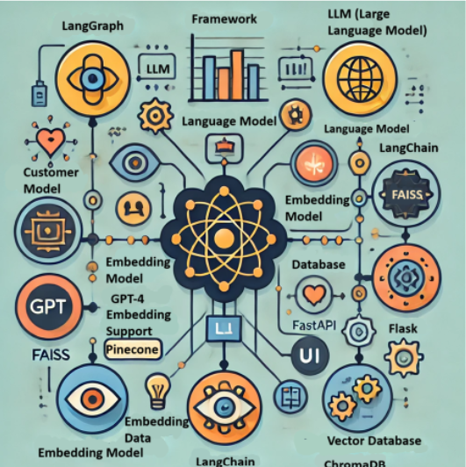
TECH ARCHITECTURE:
Component Tool/Technology
Framework-LangGraph, LangChain
LLM (Language Model)-GPT-4, Claude, LLaMA
Embedding Model-OpenAI, SBERT
Vector Database-FAISS, Pinecone, ChromaDB
UI-Streamlit, FastAPI, Flask
✅ Combines structured workflows with AI-powered retrieval & response generation.

Slide 6
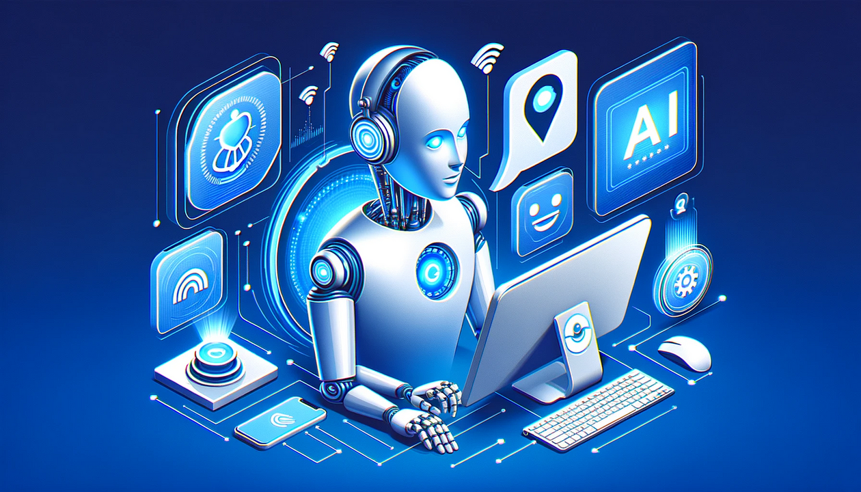
KEY BENEFITS:
✅ For Businesses – Cost-effective, scalable, and reduces human workload.
✅ For Customers – Faster & more relevant support responses.
✅ For Developers – Modular, scalable, and easy to integrate with various platforms.
✅ Improves response accuracy by leveraging retrieved knowledge dynamically.

Slide 7

Next Steps & Conclusion:
📌 Project Timeline
Week 1 – Data collection & preprocessing
Week 2 – Workflow & retrieval implementation
Week 3 – LLM integration & testing
Week 4 – UI development & final deployment
📌 Final Thoughts
✅ LangGraph improves AI agent reasoning & customer interactions.
✅ RAG enables context-aware, accurate responses.
✅ Future work: Scaling, personalization, and multi-modal integration (voice, chat, API).
02

Slide 8
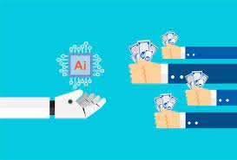
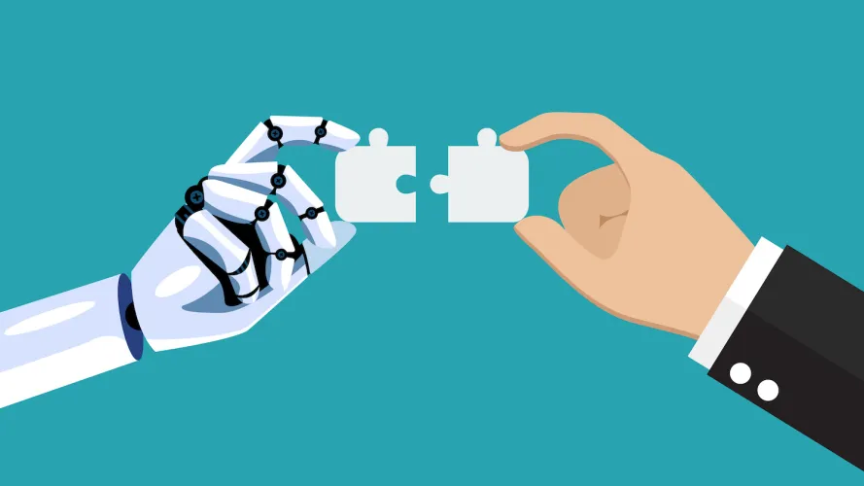

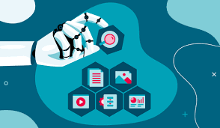
THANK YOU

